Slide 1
Fintech Lending and Debt Spiral
Lili Dai, Jianlei Han, Jing Shi, and Bohui Zhang
Presented by:
Jianlei Han
Macquarie University
Notes:
Thank you for coming to my brownbag seminar. This is my first time I present this work. I’m very much expecting your comments and suggestions. The title is Fintech lending and debt spiral. This is a joint work with Lili Dai from UNSW, JingShi from our department, and Bohui Zhang from Chinese HongKong University.

Slide 2
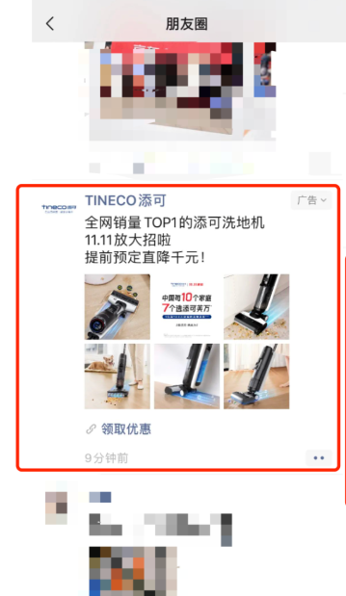
Big Data Enables Targeted Marketing
How Big Data Is Helping Advertisers Solve Problems ?(a Forbes article)
Receiving Data Analysis In Real Time
Enabling Targeted Advertising
Analyzing Customer Insights
Creating Relevant Content
Such algorithm is widely used in social apps and shopping apps.
Meta (Facebook) was fined €390m for targeted ads in Europe in Jan 2023
A reported example: One customer is chatting with his friend about robo-vacuum in an office chatting app, and later find the advertisement in his WeChat Moments Circle.
Notes:
Before talking about fintech. I want to talk a little about big data. We know that big data has significantly impacted our real life. For example, if I search big data in google, here is an article talking about how big data is helping advertisers solve problems: receiving data analysis in real time, enable targeted advertising, analyzing customer insights, and create relevant content. This kind of targeting algorithm is widely used in social apps and shopping apps. I bet you already have such experience or suspisous at least. When you do a shopping online, their recommended products will be changed to related to your recent purchase. Different countries have different standards when looking at these tactics. For example, Europe is kind of strict. Meta was fined 390 million euros for targeted ads Jan this year. Here is a reported example in news in China. One customer is chatting with his friend about robo vacuum in an office chatting app, and later find the advertisement in his Wechat moments circle.

Slide 3
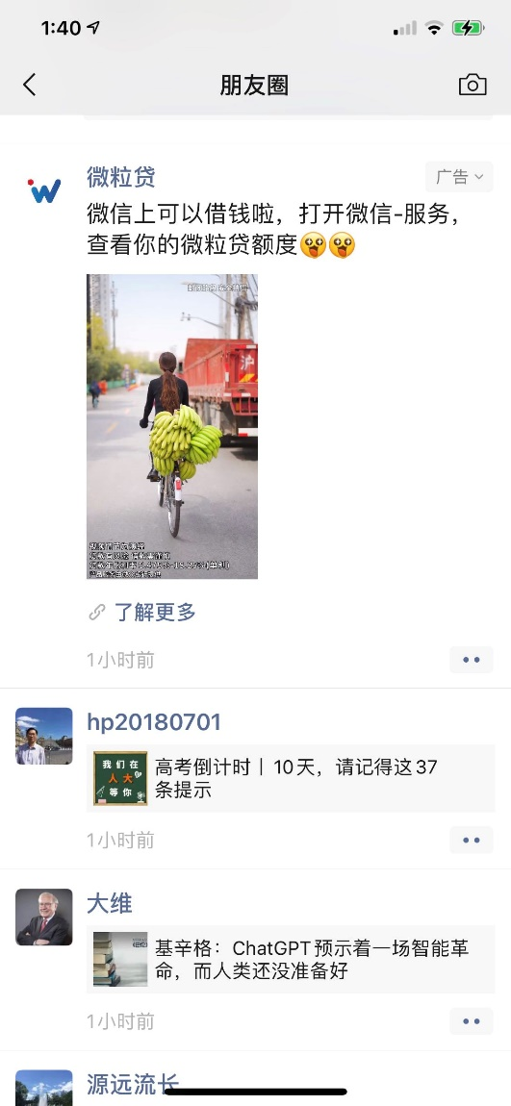
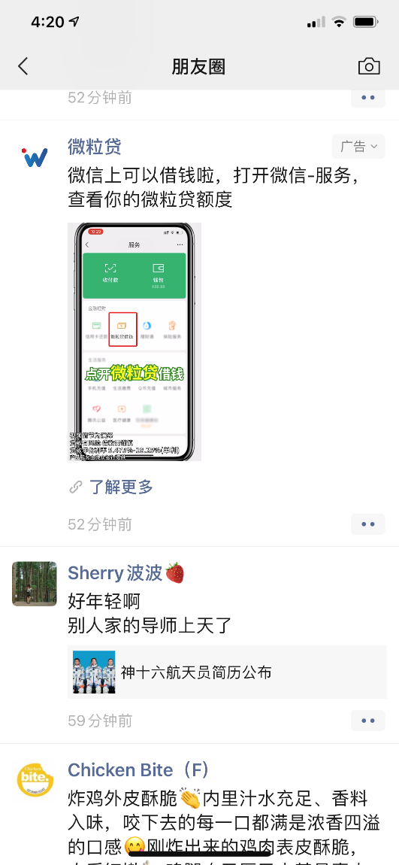
Big Data
My personal experience:
I’m chatting with my co-authors about this fintech lending paper. And this week I keep seeing advertisement of lending product in my Moments Circle.
Notes:
Here is my personal experience: I’m chatting with my coauthors about this fintech lending paper in a wechat group. And this week, everyday I can see this advertisement of fast lending product in my moments circle. The algorithm must think I’m interested in borrowing some money.

Slide 4
Fintech meets big data
Screening and monitoring: Alternative data sources for credit assessment and debt collection, expanding credit access to underserved borrowers (Berg et al. 2020; Di Maggio et al. 2022).
Technological convenience: Easy to access, streamlined application process, accelerated processing time, minimized human input.
Commercialize big data: Target and entice customers by sending advertisements strategically, to maximise the lender’s profit.
Complains about mobile advertisements from fintech lending platform (Yang 2021)
China Banking and Insurance Regulatory Commission has highlighted overborrowing risks relating to several issues, including ambiguous loan terms, induced excessive expenditures, and personal information leakage (CBIRC 2020)
Notes:
Comparing to traditional banks, fintech has its advantage of collecting data and utilizing big data. For example, they access alternative data sources such as digital footprints for credit assessment and debt collection, which helps expand access to underserved borrowers. Fintech lender provides technological convenience as well. The lending apps are easy to access, streamlined application process, accelerated processing time, and minimize human input.
On the other hand, fintech lenders commercialize big data. They target and entice customers by sending advertisements strategically, to maximise their profit. We see in industrial and regulatory report that people are complaining about mobile advertisements from fintech platforms. Regulators are concerning about overborrowing risks as well.

Slide 5
Trapped in debt spiral
Technological convenience: demand minimal effort from consumers and thus induce them to overborrow.
Amplify consumers’ self-control problem and facilitate impulse-driven expenditures (Berg et al. 2022)
Consumers with time-inconsistent taste for immediate gratification (Benton et al. 2007; Heidhues and Koszegi 2010)
Promotional mobile messages: strategically target consumers with strong and urgent demand for credit.
typically associated with a high level of poverty, underserved by banks (Hau et al. 2019; Di Maggio et al. 2022)
poverty can perpetuate itself by further undermining individuals’ self-control capacity (Bernheim et al. 2015)
Notes:
We show in this paper that borrowers are easily get trapped in debt spiral. There are two reasons: firstly, because of the technological convenience, the lending apps demand minimal effort from consumers and thus induce them to overborrow. The convenience amplify consumers’ self-control problem and facilitate impulse-driven expenditures. And consumers usually have time-inconsistent taste for immediate gratification. Secondly, fintech utilize big data to strategically target consumers with strong and urgent demand for credit. These consumers are typically associated with a high level of poverty, underserved by banks. The poverty can perpetuate itself by further undermining individuals’ self-control capacity.

Slide 6
Findings I
We use a set of loan applications data and the mobile message logs of the borrowers from a leading fintech company in China.
Promotional message. We find that borrowers obtained the loan from the focal fintech lender receive more promotional messages from other lenders.
New loan registration. Borrowers who receive more promotional messages are more likely to apply and register new loans from other lenders.
Personal expenditure. Borrowers who register new loans induced by the promotional messages have higher daily expenditure.
New loan delinquency. Borrowers who register new loans induced by the promotional messages are more likely receiving debt collection messages indicating loan delinquency.
Negative externality: social outcomes. Borrowers who register new loans induced by the promotional messages are experiencing more negative messages such as “divorce”, “breakup” etc.
Notes:
Before we go to detail, I want to briefly introduce our findings. We use a set of loan applications data and the mobile message logs of the applicants from a leading fintech company in China. We name this lender as focal lender thereafter. Our first finding is that borrowers who obtained the loan from the focal fintech lender receive more promotional messages from other lenders. Secondly, we find that borrowers who receive more promotional messages are more likely to apply and register new loans from other lenders. Thirdly, we find that borrowers who register new loans induced by the promotional messages have higher daily expenditure. Fourthly, we find that borrowers who register new loans induced by the promotional messages are more likely to be delinquent. Finally, we show the negative externality of the debt spiral, the social outcomes. We show that borrowers who register new loans induced by the promotional messages are experiencing more negative conversation messages such as “divorce”, “breakup”.

Slide 7
Findings II: Mechanism and Implications
Financial Literacy. The results related to debt spiral are more pronounced for the borrowers from areas with lower financial literacy.
Financial Access. The results related to debt spiral are more pronounced for the borrowers from areas with lower credit access to traditional financial institutions.
Social Insurance. The results related to debt spiral are more pronounced for the borrowers from areas with lower unemployment insurance coverage ratio.
Notes:
Our second group of results are related to mechanism and implications. We show that the results related to debt spiral are more pronounced for the borrowers from areas with lower financial literacy, restricted financial access to traditional institutions, and lower coverage of social insurance. The implication is that, improve the borrower’s knowledge about financial plan and management, increase traditional bank’s financial inclusion, and social insurance coverage can help them avoid been targeted by the predatory lenders and improve their self-control.

Slide 8
Literature
Overborrowing ,financial distress, and negative social impact
Allcott et al. (2022, REST), Bernheim et al. (2015, Econometrica), Melzer (2011, QJE), Heidhues et al. (2010, AER), Bertrand and Morse (2011,JF), Skiba and Tobacman (2019,JLE), Lin and Pursiaien (2022,JFE)
Trade-off between personal data privacy and access to credit
Berg et al. (2020,RFS), Chen et al. (2021), Peukert et al. (2022,MS), Tang (2021)
Notes:
Our research contributes to two main areas: the first one is related to overborrowing, financial hardship, and negative social impact. This is a very important area, we see a lot of top econ journals in this topic such as Review of economic studies, econometrica, QJE, AER, and top finance journals. The second area is relating to the trade-off between personal data privacy and access to credit. This is a more emerging topic in finance.

Slide 9
Data
52,307 Loan applications from a leading fintech lender (focal lender) in China from 2017-2019.
54.8% are approved
Median age 24
12.5% are female
The applicants’ mobile message logs, covering before and after the loan application.
Totally 2,787,505 borrower-day observations relating to
83.6 million messages.
Notes:
Our data is from a leading fintech lender, which we name it as focal lender in China. Our data includes 52,307 loan applications, where 54.8% of them are approved loans. The applicant has a median age of 24. 12.5% of them are female. We also have their mobile message logs, covering before and after the loan application. Our sample has totally 2.78 million borrower-day observations, relating to 83.6 million messages.

Slide 10
Mobile Message Log
A typical promotion message from a lending platform:
“[Ant Credit Pay] Congratulations! You are successfully included in our whitelist for a credit line of 15,000 yuan! Apply within one hour to get the money. Reply T to unsubscribe.”
Identify non-focal lenders
Company name needs to be bracketed, required by regulator (MIIT)
Applying this rule, we extract all company names from the messages.
We manually check whether the company is a lender
4,274 unique non-focal lenders identified from our data.
Identify passive promotional messages (Message _{Passive} )
Promotional messages a borrower passively receive
Key words such as “applying and receiving loan immediately,” “loan interest waived,” and “activate your credit quote.”
Compulsory keyword “unsubscribe”, required by MIIT for marketing messages.
Notes:
Here is a typical example of promotion message. Ant credit pay is the company name or platform name. There are two compulsory terms for identifying such messages. First, the company names much be included and bracketed in the message, required by regulator. Second, all promotional messages must include unsubscribe term. So our first step is to identify non-focal lenders. We extract all company names from the bracket, and manually check whether the company is a lender. We identified 4,274 unique lenders from our data. Then we identify passive promotional messages. Passive means that the promotion message is not triggered by the borrower’s active visit or registering. We use promotional keywords such as “applying and receiving loan immediately”, “loan interest waived”, “activate your credit quote” and a compulsory keyword “unsubscribe” to identify such messages. We name the daily number of this message as message passive.

Slide 11
Mobile Message Log
Identify proactive promotional messages (Message _{Proactive} )
Promotional messages after the borrower approached the lender
Keywords such as “account registered” and “complete personal profile” .
Example: “[Cloud Fast Loan] Congratulations! you have passed the preliminary assessment. Please complete your personal profile to receive the money!”
Identify new loan registration messages (Loan Registration)
Messages indicating a new loan registration
Confirmation messages with verification code for loan registration for verifying identity.
Example: “[360 Fast Loan] Your loan application verification code is 404404. Please do not share with others.”
Notes:
Then we identify proactive promotional messages. Such messages are trigged by borrower’s active approaching such as filled in some information on the website. We use keywords such as account registered, complete personal profile. Here is an example from cloud fast loan. We name the daily count of such message as message proactive. Next we identify new loan registration messages. When the borrower register and apply in a new lending platform, the platform must send a confirmation message with verification code to verify their identity.

Slide 12
Mobile Message Log
Enticed loan registration (Loan Registration _{Enticed}) : apply for a loan from platform who has sent promotional messages within the previous week.
Spontaneous loan registration (Loan Registration _{Spontaneous} ) : apply for a loan from platform who didn’t send promotional messages within the previous week.
Identify messages of the expenditure(Expenditure)
Transaction record messages from WechatPay and Alipay
Sum up the amount
Example : “[WechatPay] Your payment at 2018-03-19 17:03:18 is successful, paid 200.00 yuan”
Identify delinquency messages of the new loans (Collection)
Debt collection messages
Keywords such as “overdue” and “delinquent”
Example: “[Immediate Consumer Loan] Your installment is delinquent. Your overdue amount is 2371.83 Yuan by 11-25. Please repay asap to avoid consequences.”
Notes:
We also split the new loan registration to two types: one is enticed loan registration. It means that the new loan is from the platform who has sent promotional messages within the previous week. Another type is spontaneous loan registration. It is applying for a loan from platform who didn’t send promotional messages within the previous week. Next we identify messages indicating the borrowers’ expenditure. We identify messages from Wechat Pay and Alipay, the two largest payment apps in China. We sum up the transaction amount for a day for the borrowers. Next we identify delinquency messages of the new loans. We find the debt collection messages, with keywords such as “overdue” and “delinquent”. Here is a debt collection message example.

Slide 13
Identify negative social outcome (Conversation)
Messages indicating negative social consequences
Keywords in relation to “divorce,” “breakup,” “suicide,” “detention,” “in jail,” “curse,” “bastard,” “fight,” “runaway,” “fraud,” “liar,” “call the police,” and “home violence.”
Example: “I failed. I owe money. If you really want to divorce, I agree. Don’t make both of us too tired…”
Notes:
Lastly, we identify the messages indicating negative social outcomes. We check keywords in relation to divorce, breakup, suicide, … Here is an example:

Slide 14
Loan approval and promotional message
Difference-in-difference setting for the impact of focal loan approval on the number of promotional messages:
Message = α + β × Approval × Post + β_{Control} ×Control Variables × Post + β_{FE} Fixed Effects + ε,
Message : number of passive/proactive promotional messages
Approval : whether the borrower’s application to the focal lender get approved
Post : after the loan approval decision
Notes:
Our first test is to test the loan approval and subsequent promotional messages. We use a diff-in-diff setting. The dependent variable message is the number of passive or proactive promotional messages. Approval is indicating whether the borrower’s application to the focal lender get approved. Post is indicating after the loan approval decision.

Slide 15
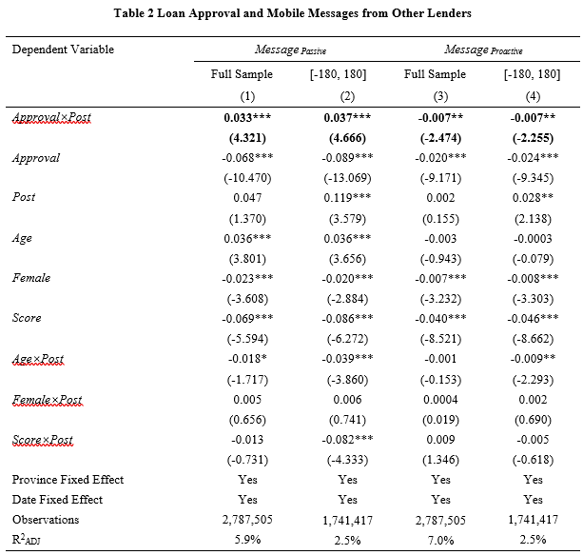
Loan approval and promotional message
Coefficients on Approval × Post are significantly positive for passive promotional messages
Coefficients are negative for proactive promotional messages
Notes:
Here is our diff-in-diff test results. The coefficients on approval times post are significantly passive for passive promotional messages, indicating that after the borrower’s loan get approved, the borrower receives more passive promotional messages. Proactive messages are negative, indicating that after getting the loan, the borrowers reduce their searching for new lending platforms.

Slide 16
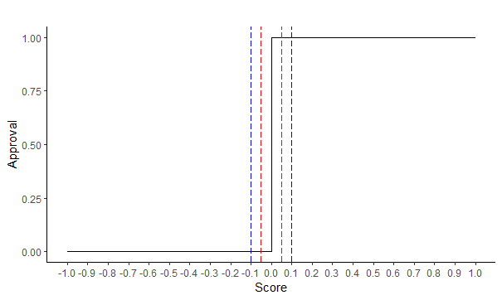
Identification: RDD strategy
Potential endogeneity concern: borrowers with different credit quality attract ads differently.
Sharp Regression Discontinuity Design (RDD)
The loan approval is purely determined by the focal lender’s credit model score.
Cut the sample close to the cut-off point Score=0: [-0.05,0.05];[-0.1,0.1]
Notes:
Potential endogeneity concern: borrowers with different credit quality attract ads differently. To address this type of concern, we utilize a sharp regression discontinuity design. The loan approval is purely determined by the focal lender’s credit model score. The loan is approved if the score is greater than 0. We cut the sample close to the cut-off point score =0.

Slide 17
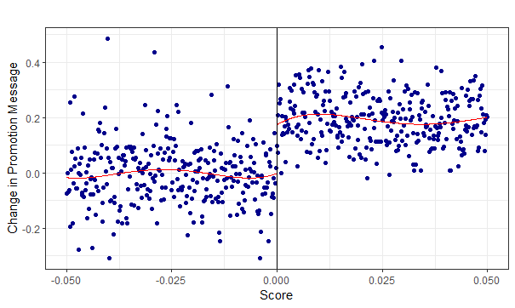
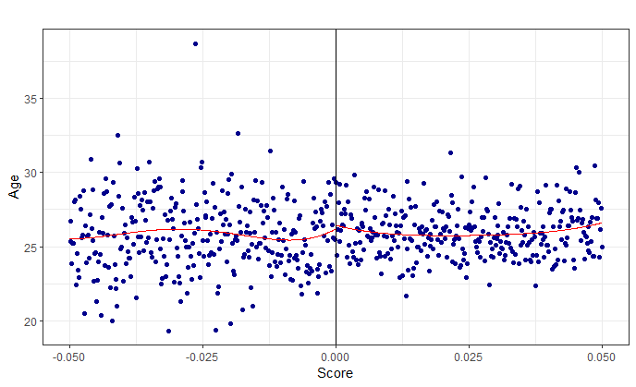
RDD strategy
Preliminary result Score at [-0.05,0.05]:
Change of passive promotional messages significantly jump in the cut-off point
Control variable example Age has no change around the cutoff point.
Notes:
Here is a graph to show the preliminary result with the score in the range of [-0.05,0.05]. The dots indicate the change of number of passive promotion messages, one week after the loan decision to one week before the loan decision. The bottom graph is an example of the control variable age. It shows no change around the cut-off point.

Slide 18
RDD model
Sharp RDD test model for the impact of focal loan approval on the number of promotional messages:
Message = α + β × Approval × Post + β₁ × Score × Post+ β₂ × Score² × Post+ β₃ × Approval × Score × Post+ β₄× Approval × Score² × Post + β₅× Score+ β₆ × Score² + β_{Control} ×Control Variables × Post + β_{FE} Fixed Effects + ε
Restrict our sample to the range of Score within [-0.05,0.05] or [-0.1,0.1]
Notes:
Here is the RDD model of the formal test. We include score, score square, and their interaction terms. And we restrict our sample to the two small ranges around the cutoff point.

Slide 19
RDD results
 | Message _{Passive} |  | Message _{Proactive}
 | Score in [-0.05, 0.05] | Score in [-0.1, 0.1] | Score in [-0.05, 0.05] | Score in [-0.1, 0.1]
 | (1) | (2) | (3) | (4)
Approval×Post | 0.023*** | 0.016*** | -0.007 | -0.012***
 | (2.805) | (2.730) | (-1.449) | (-3.724)
Score×Post | -1.712*** | -0.075 | 0.006 | 0.221*
 | (-2.940) | (-0.379) | (0.022) | (1.879)
Score²×Post | -43.396*** | -0.966 | -3.028 | 1.985*
 | (-3.824) | (-0.493) | (0.090) | (1.735)
Approval×Score×Post | 3.056*** | 0.437 | -1.496 | -0.088
 | (4.236) | (1.711) | (-0.199) | (-0.601)
Approval×Score²×Post | 11.603 | -3.365 | -1.496 | -4.034***
 | (0.792) | (-1.302) | (-0.199) | (-2.773)
Controls | Yes | Yes | Yes | Yes
Obs | 633,150 | 1,296,330 | 633,150 | 1,296,330
The loan approval by the focal lender significantly increases the number of passive promotional messages.
Notes:
This is our RDD result. The results show that the loan approval significantly increases the number of passive promotional messages. The effect for proactive message is still negative but not very stable.

Slide 20
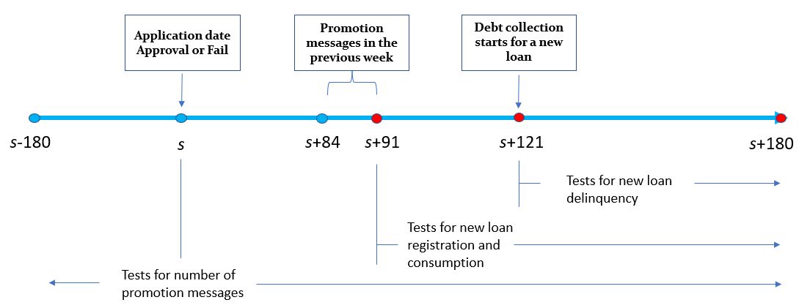
Tests of Consequences
Tests of consequences: New loan registration, personal consumption, new loan delinquency.
Notes:
Next we are going to test the consequences. I draw a timeline to show how we are going to construct our samples to do the tests. The total period is for our baseline test, testing for number of promotion messages. To test new loan registrations, we start from s+91, which is three months after the loan from focal lender. We try to avoid the impact of the loan from the focal lender. Our independent variable would be number of passive promotion messages in the previous week. The sample period is used for testing daily consumption. 30 days after taking a new loan, that is s+121, we start the sample to test for new loan delinquency.

Slide 21
New loan registration
Sample starts from day s+91, Score range [-0.05,0.05]
IV approach, taking advantage of sharp RDD
Stage 1:
Message _{Passive, Week} = α₁ + β₁₁ × Approval + β₁₂ × Approval × Score+ β₁₃ × Approval× Score² + β_{Control} ×Control Variables + β_{FE} Fixed Effects + ε,
Message _{Passive, Week} : passive promotional messages in the previous 7 days.
Stage 2:
Loan Registration= α₂ + β₂₁ × Message _{Passive, Predicted} + β₂₂ × Approval × Score+ β₂₃ × Approval×Score² + β_{Control} ×Control Variables + β_{FE} Fixed Effects + ε
Message _{Passive, Predicted} : fitted value Message _{Passive, Week} of Message _{Passive, Week} in stage 1.
Notes:
To test the new loan registration, we use an IV approach, taking advantage of the sharp RDD. We also restrict our sample to the range of [-0.05,0.05]. The first stage, we run the RDD model for the passive promotional messages in the previous 7 days. In second stage, we use the fitted value of the passive promotional messages as the independent variable. Other settings are consistent with our RDD model.

Slide 22
New loan registration
Dependent Variable | Message _{Passive, Week} | Loan Registration _{Total} |  | Loan Registration _{Enticed} |  | Loan Registration _{Spontaneous}
 | First Stage | Second Stage |  | Second Stage
 | (1) |  | (2) | (3) | (3) | (4) | (4)
Approval | 0.087***
 | (7.202)
Message _{Passive, Predicted} |  |  | 0.186*** | 0.159*** | 0.159*** | 0.053*** | 0.053***
 |  |  | (2.635) | (2.264) | (2.264) | (6.793) | (6.793)
Controls | Yes |  | Yes | Yes | Yes | Yes | Yes
Obs | 262,947 |  | 262,947 |  | 262,947 |  | 262,947
Fist stage: Focal lender’s approval significantly increases the number of passive promotional messages.
Second stage: The predicted number of passive promotional messages significantly increases new loan registrations, for both enticed ones and spontaneous ones. The effect is stronger for enticed ones.

Slide 23
Personal expenditure
Sample starts from day s+91, Score range [-0.05,0.05]
Daily sum of transaction record messages from Wechat Pay and Ali Pay
2nd stage model:
Expenditure= α + β₁ × Message _{Passive, Predicted} + β₂ × Approval × Score+ β₃ × Approval×Score² + β_{Control} ×Control Variables + β_{FE} Fixed Effects + ε
Two sub-samples:
Borrowers who have taken a new loan (Registrant)
Borrowers who haven’t taken a new loan (Non-Registrant)
Notes:
Then we test the personal expenditure, using the same setting. The key variable is the predicted passive promotion messages in the previous week. We also constructed two sub-samples, one is those who have taken a new loan, the other one is those who haven’t taken a new loan.

Slide 24
Personal expenditure
Dependent Variable | Expenditures _{Indicator} |  |  |  | Expenditures _{Amount}
 | Full Sample | Registrants |  | Non-Registrants | Full Sample | Registrants |  | Non-Registrants
 | (1) | (2) |  | (3) | (4) | (5) |  | (6)
Message _{Passive, Predicted} | 0.111*** | 0.243*** |  | -0.102 | 0.447*** | 0.734*** |  | -0.042
 | (2.163) | (3.535) |  | (-1.273) | (2.895) | (3.416) |  | (-0.179)
Difference |  | 0.345*** |  |  |  | 0.776**
 |  | (3.268) |  |  |  | (2.439)
Controls | Yes | Yes | Yes |  | Yes | Yes | Yes
Obs | 262,947 | 129,909 | 133,038 |  | 262,947 | 129,909 | 133,039
Predicted passive promotion messages significantly increase expenditure
The effect is concentrated in the sample of borrowers who have taken a new loan (Registrants)

Slide 25
New loan delinquency
Sample starts from day s+121, score range [-0.05,0.05], only observations with borrowers who have taken a new loan (Registrant)
Debt collection messages with keywords “overdue”, “delinquent”
2nd stage model:
Collection= α + β₁ × Message _{Passive, Predicted} + β₂ × Approval × Score+ β₃ × Approval×Score² + β_{Control} ×Control Variables + β_{FE} Fixed Effects + ε

Slide 26
New loan delinquency
Dependent Variable | Collection _{Indicator} | Collection _{Number}
 | (1) | (2)
Message _{Passive, Predicted} | 0.315*** | 0.226***
 | (4.561) | (4.390)
Controls | Yes | Yes
Obs | 56,903 | 56,903
Predicted passive promotional message induced new loans have significantly higher likelihood of loan delinquency.

Slide 27
Negative social outcome
Sample starts from day s+91, score range [-0.05,0.05]
Negative conversation messages with keywords “divorce,” “breakup,” “suicide,” “detention,” “in jail,” “curse,” “bastard,” “fight,” “runaway,” “fraud,” “liar,” “call the police,” and “home violence.”
2nd stage model:
Conversation= α + β₁ × Message _{Passive, Predicted} + β₂ × Approval × Score+ β₃ × Approval×Score² + β_{Control} ×Control Variables + β_{FE} Fixed Effects + ε

Slide 28
Negative social outcome
Sample starts s+91, restricted to new loan registrants
Dependent Variable | Conversation _{Indicator} | Conversation _{Number}
 | (1) | (2)
Message _{Passive, Predicted} | 0.027* | 0.021**
 | (1.947) | (1.962)
Controls | Yes | Yes
Obs | 129,909 | 129,909
Predicted passive promotional message induced new loans have significantly higher likelihood of experiencing negative social consequences.

Slide 29
Mechanisms
Financial literacy
Borrowers with limited knowledge and experience for personal financial management are more vulnerable to predatory lending(Lusardi and Scheresberg 2013; Allcott et al. 2022)
Financial literacy score constructed by 2017 China Household Finance Survey (CHFS) data
Credit Access
Borrowers with limited access to traditional financial services are more targeted by fintech lenders.
A set of questions related to traditional financial inclusion by 2017 CHFS
Social Insurance
Borrowers who face a lower level of unemployment insurance coverage tend to be more vulnerable to the enticement of overborrowing and engage in debt spirals.
Unemployment insurance coverage ratio by 2017 CHFS
Notes:
Then we test the three mechanisms. The first one is financial literacy. Borrowers with limited knowledge and experience for personal financial management are more vulnerable to predatory lending. We construct financial literacy score by the set of financial literacy questions in the 2017 China Household Finance Survey. The second one is credit access. Borrowers with limited access to traditional financial services are more targeted by fintech lenders. We use a set of questions related to traditional financial inclusion by 2017 CHFS to measure credit access. The last one is social insurance. Borrowers who face a lower level of unemployment insurance coverage tend to be more vulnerable to the enticement of overborrowing and engage in debt spirals. We use unemployment insurance coverage ratio by 2017 CHFS.

Slide 30
Mechanism tests
Dependent Variable | Loan Registration _{Enticed} | Expenditures _{Indicator} | Collection _{Indicator} | Conversation _{Indicator}
 | (1) | (2) | (3) | (4)
Message _{Passive, Predicted} × | 0.013** | 0.019*** | 0.022** | 0.001
Financial Literacy _{Low} | (2.988) | (2.739) | (2.847) | (0.795)
Dependent Variable | Loan Registration _{Enticed} | Expenditures _{Indicator} | Collection _{Indicator} | Conversation _{Indicator}
 | (1) | (2) | (3) |  | (4)
Message _{Passive, Predicted} × | 0.015** | 0.020*** | 0.015** |  | 0.004**
Credit Access _{Low} | (3.407) | (2.763) | (1.969) |  | (2.442)
Dependent Variable | Loan Registration _{Enticed} | Expenditures _{Indicator} | Collection _{Indicator} | Conversation _{Indicator}
 | (1) | (2) | (3) |  | (4)
Message _{Passive, Predicted} × | 0.021*** | 0.020*** | 0.005* |  | 0.0003
Social Insurance _{Low} | (4.728) | (2.862) | (1.667) |  | (0.198)
Notes:
Here are the mechanism tests results. The results shows that the debt spiral outcomes are more significant for those from areas with lower financial literacy score, lower credit access and lower coverage of unemployment insurance.

Slide 31
Conclusion
We show that a loan from a focal lender significantly increase the number of promotional messages of other lenders to the borrowers.
The promotional messages entice borrower to apply for new loans, expend more money, and more likely to delinquent for new loans.
This kind of debt trap has negative social externality beyond the financial distress.
Such effects are stronger for borrowers with lower financial literacy, traditional credit access, and lower social insurance.
Political implications
regulations on predatory lending strategies such as target ads.
Improve financial literacy, financial inclusion, and social insurance.

